Slide 1
Understanding
Convolutional Neural Networks on Protein Secondary Structure Prediction
Guillermo Romero

Slide 2
Introduction

Slide 3
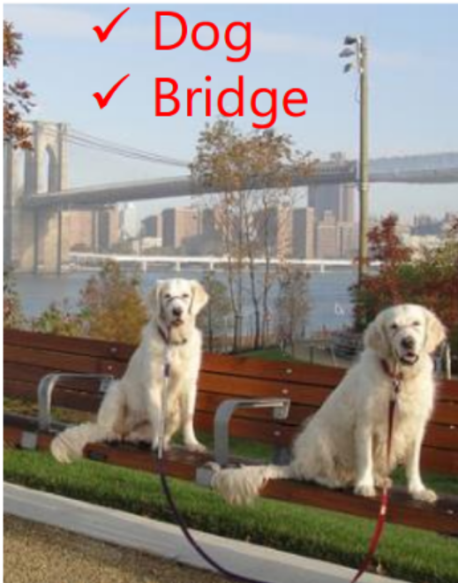

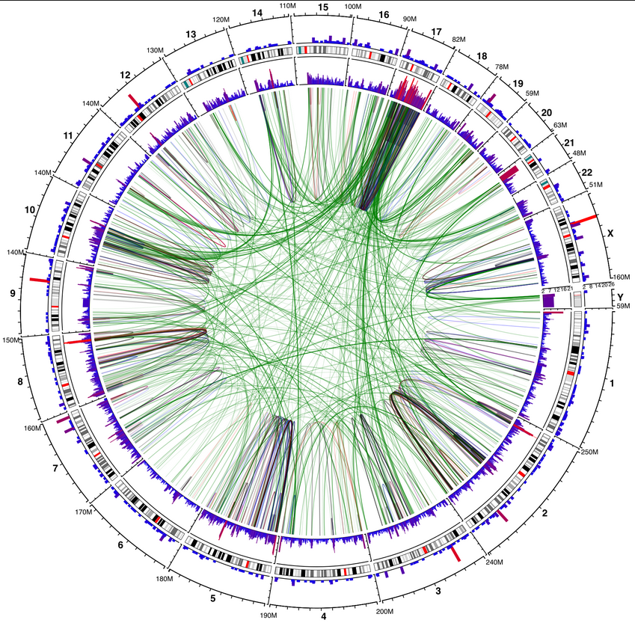
CV, NLP, etc. VS Bioinformatics
CV, NLP, etc: we use systems for learning things that we know perfectly how to do, but cannot formalize.
Bioinformatics: we use systems for learning underlying complex processes that we don’t know, and we hope to learn better from them.

Slide 4
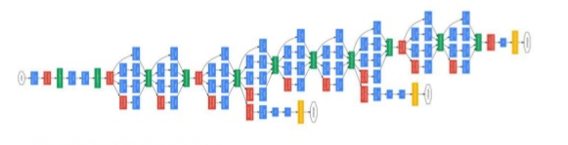
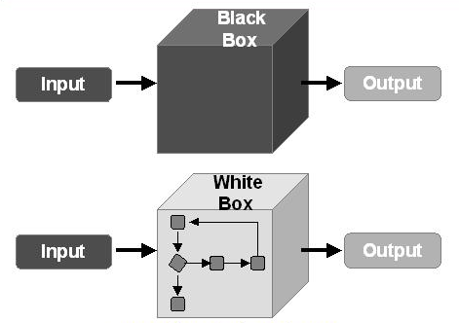
The arrival of Deep Learning
Systems grow in size and complexity, so are able to learn more complex patterns
We also lose interpretability of the machines and their pedagogic capabilities along the way

Slide 5
Rediscovering interpretability
Some techniques have been developed for interpreting deep networks, although their main purpose is to debug the machines for improving them
In this project, I transfer some of these techniques to a biological problem and prove how they can be used for discovering facts from exploring the model

Slide 6
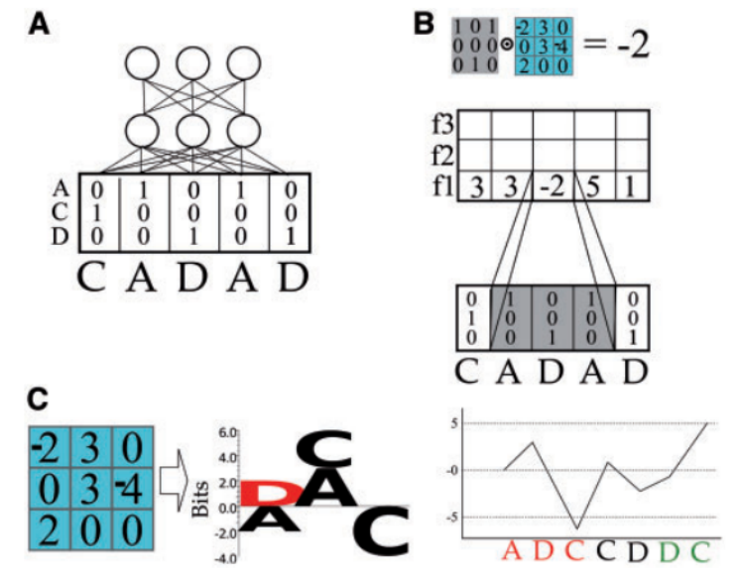
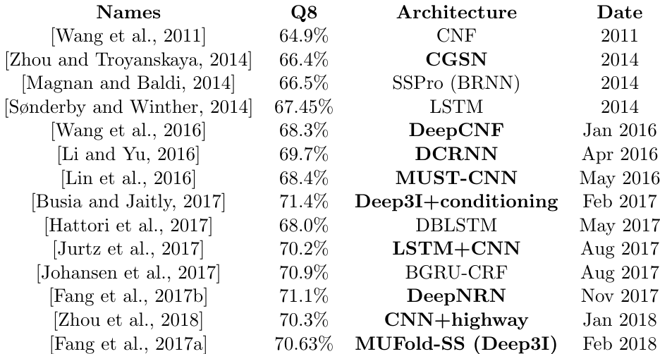
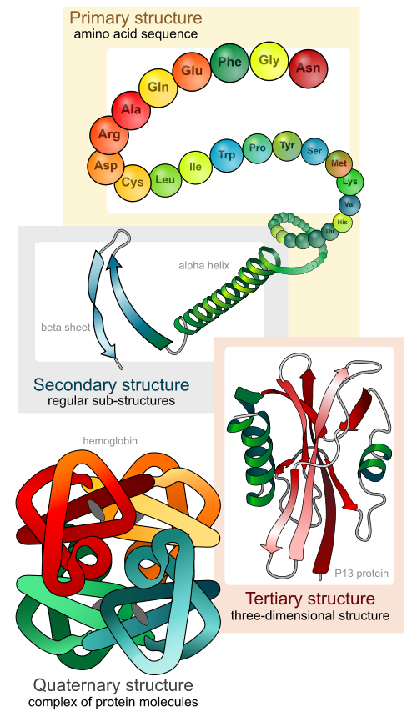
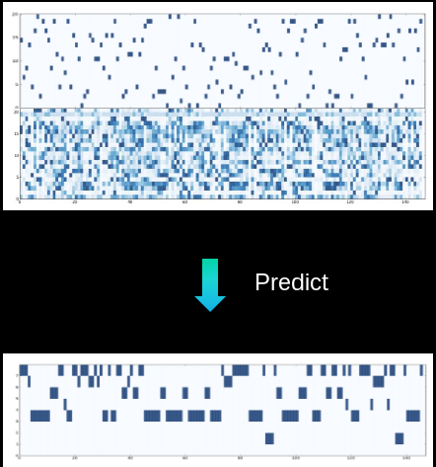
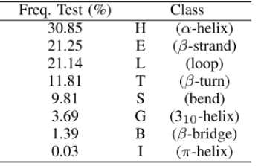
Protein secondary-structure prediction and CNNs
Inputs:
21 amino-acids (one-hot)
Position-Specific Scoring Matrix
Outputs:
8 classes labels
Notes:
- Proteins fold into 3D structure, which determines their function
- Drug, enzyme design,
- High cost of experimental protein structure determination and low cost of DNA sequencing
- 85M proteins discovered, 130k 2ary struct known
- Extremely challenging 3D from sequence alone
- Intermediate step (constrains): secondary structure, local conformations of peptide backbone alpha-helix (3), beta-strand (2), coil (3)
- Structural labelling: many-to-many sequence problem
- Other problems: backbone angle, contact number, solvent accesibility area. Many-to-one: intrinsic disorder prediction, subcellular area

Slide 7
Theory and state-of-the-art

Slide 8
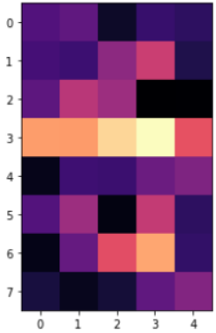
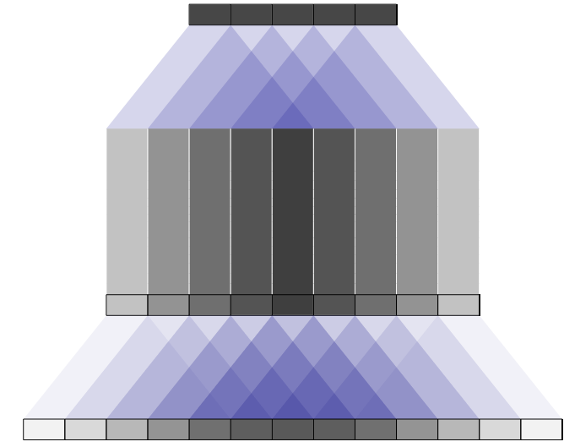
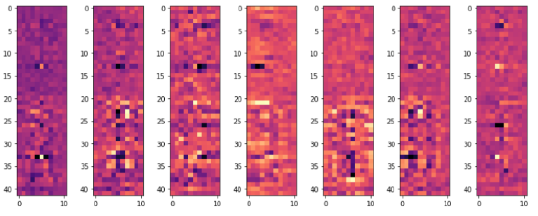
Simple methods
Visualize filters of first layer know higher level features
Visualize filters of higher layers from linear combination of lower filters:
  But it loses the non-linearities and has overlapping problems

Slide 9
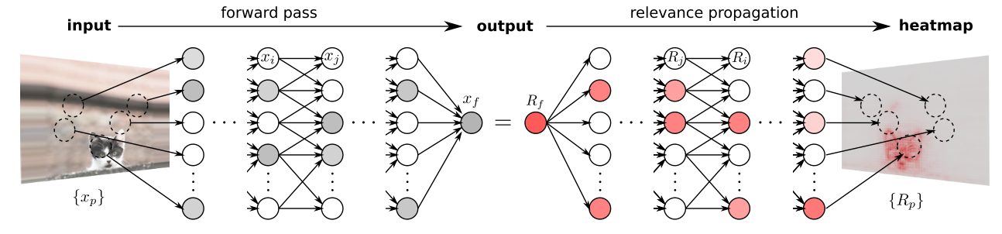
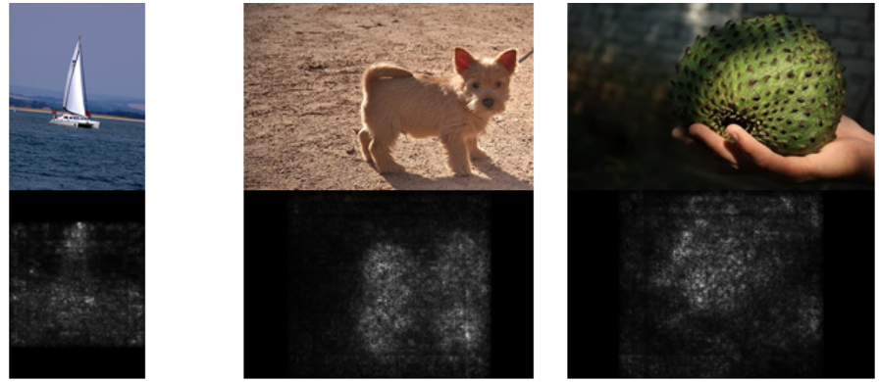
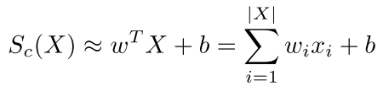

Saliency Maps
First order derivatives (Taylor expansion)

Slide 10

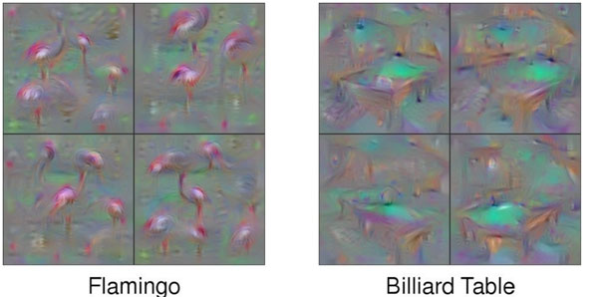
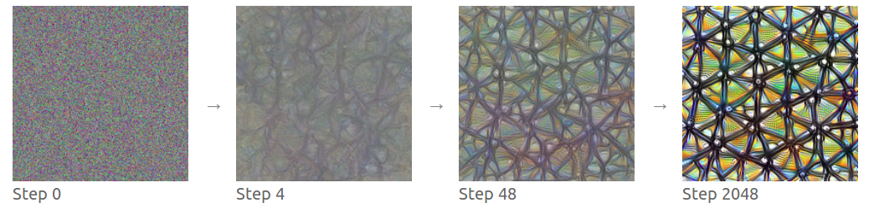
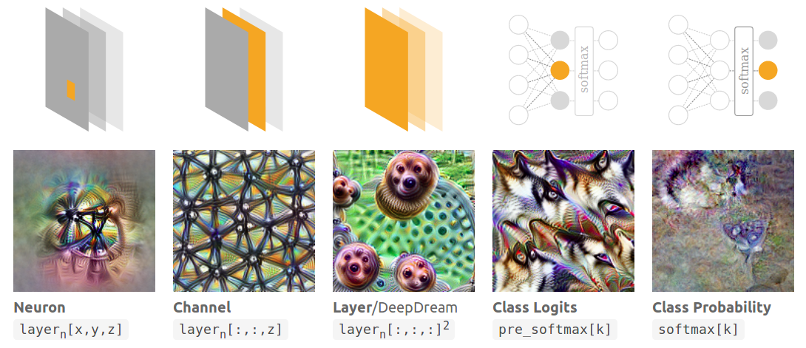
Activation maximization

Slide 11
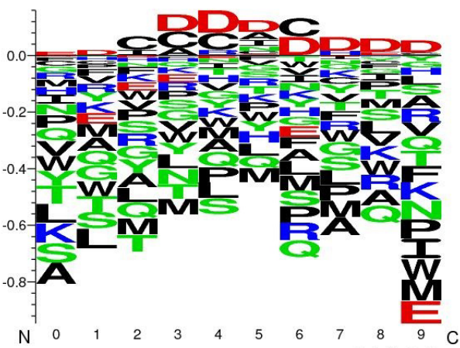
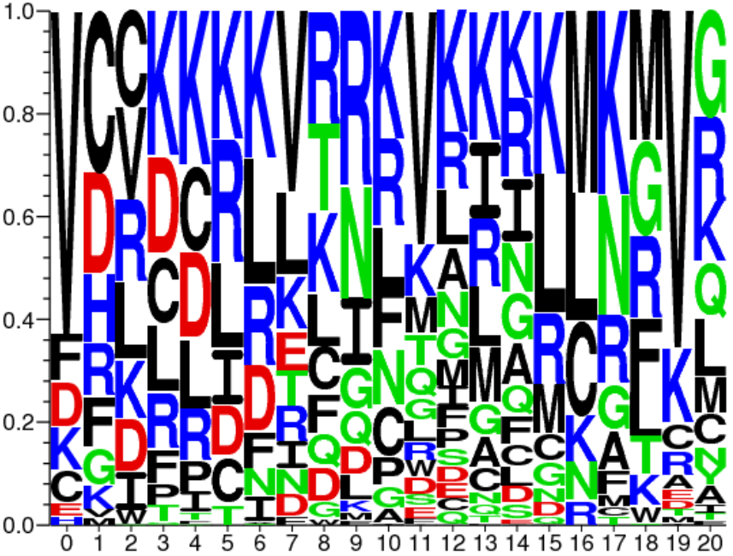
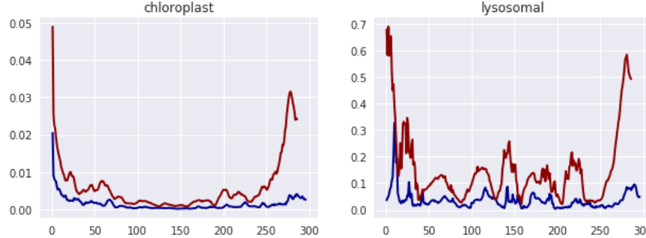
Previous work of model understanding with biological sequence data
A. Fontal, Neural Networks for Subcellular Localization Prediction, Wageningen University & Research, 2017.
Activation maximization
No prior, potentially
unnatural samples
No convergence
1st filters
representation
Only 1-layer of CNN
Signal
Masking
approach

Slide 12
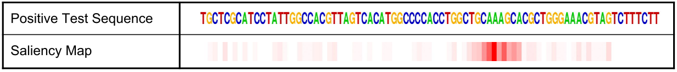
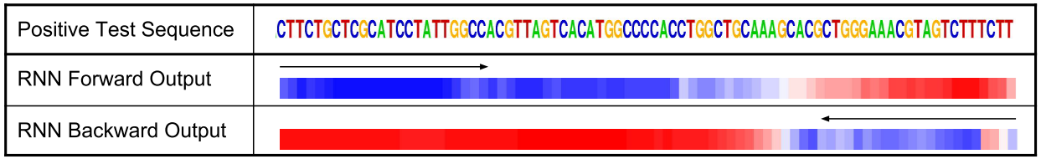
J. Lanchantin, R. Singh, B. Wang, and Y. Qi, Deep Motif Dashboard: Visualizing and Understanding Genomic Sequences Using Deep Neural Networks, 2016.
Transcription factor binding (TFBS) site classification task on DNA sequence
Saliency maps
Activation maximization
Temportal output scores For LSTMs

Slide 13
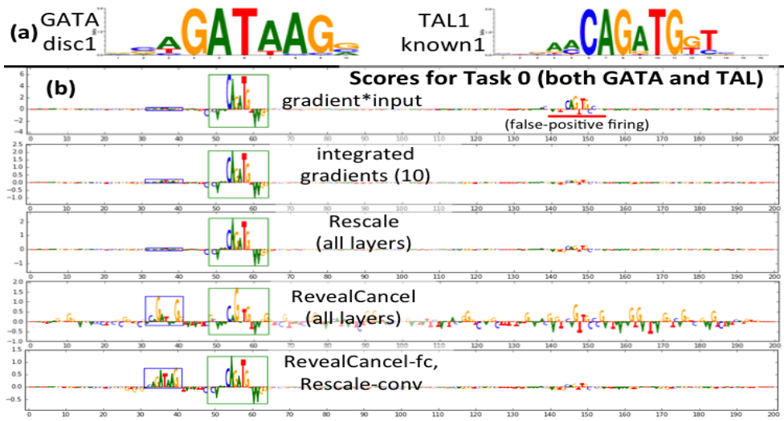
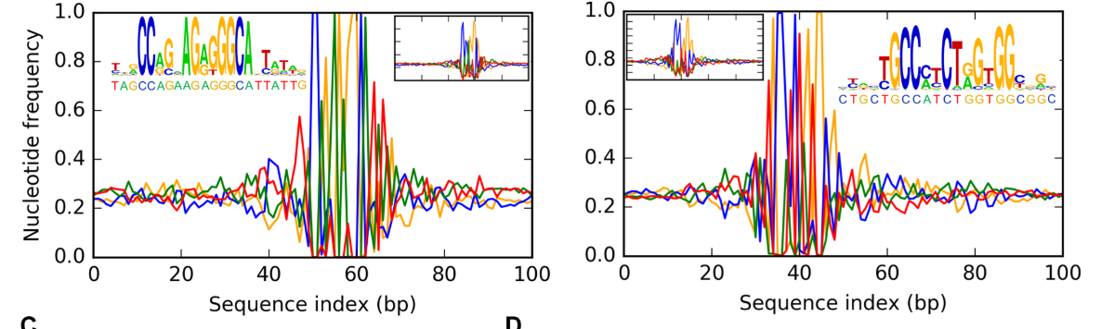
A. Shrikumar, P. Greenside, and A. Kundaje, Learning Important Features Through Propagating Activation Differences, Apr. 2017.
Develop new way of
  calculating saliencies
I’m currently
using this one
A. Finnegan and J. S. Song, Maximum entropy methods for extracting the learned features of deep neural networks, PLoS Comput. Biol., 2017.
Probabilistic methods
with MCMC
on DNA sequences

Slide 14
Methods and results

Slide 15
Network of analysis
My own CNN network (simple)
Three convolutional layers, with filters of size 3, 5 and 7, and 16 filters per size
Skip connections from all previous layers (a la ResNet)
Total window size: 19 (9 per side)
Trained on 5504 sequences, tested on 514

Slide 16

Class logits
(pre-softmax)
L x 1
Filter
7 x 5
Hidden L x 7
Filters
42 x 11
Input
L x 42

Slide 17
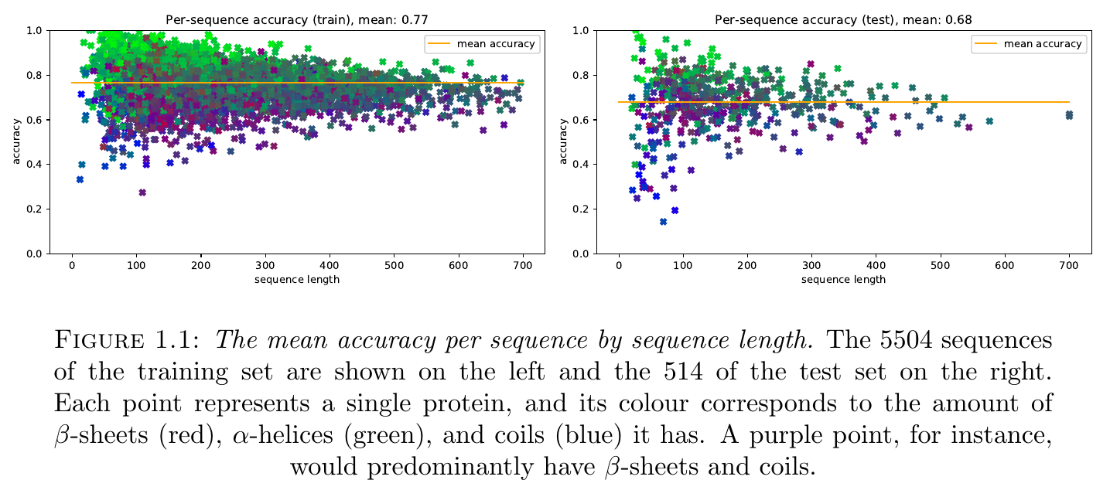
Performance
Accuracy 67.7% (similar to the state-of-the-art from 2 years ago, currently it’s around 71%)
It seems to perform worse in sequences with high percentage of beta-strands

Slide 18
Saliency maps
Calculated by gradient * inputs
~1.3 millions 8x42x19 saliency maps (1.3 positions, 8 classes, 42 inputs, 19 window size)
They can be aggregated in different ways for obtaining information about the network:
  Sequence-specific: look at a single sequence and see why predictions were made in certain ways
  Class-specific or pssm-specific: aggregate all saliency maps in order to obtain general information about the predictions

Slide 19
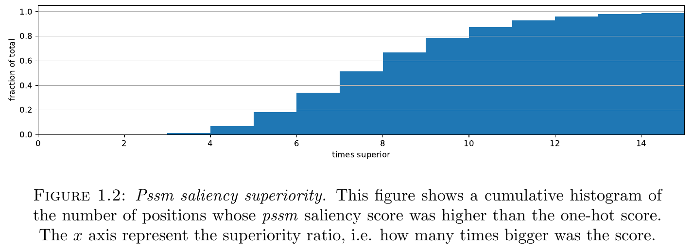
PSSM vs one-hot
Each saliency map is divided into two groups of 8x21x19 (one-hot and pssm) and the absolute values of each group are added up to a single score, wich captures the relevance of the group
All scores from pssm are higher, except for one

Slide 20
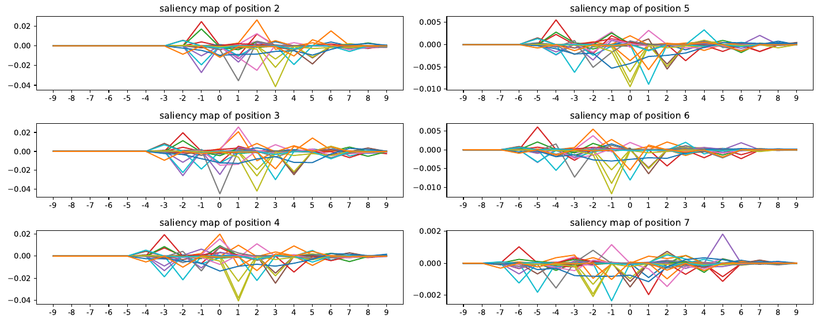
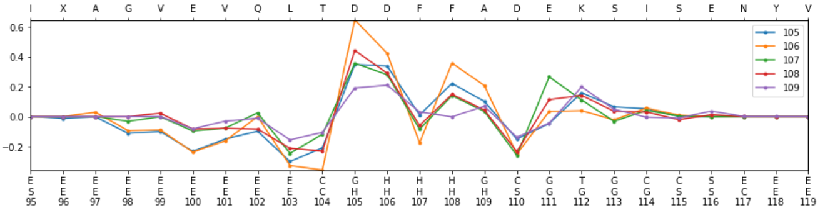
Sequence-specific saliency map
Sliding sequences: for consecutive positions saliency maps are almost the same, but shifted on one position on the window
It seems reasonable to align and aggregate them on a single 8x42xseq_length map

Slide 21
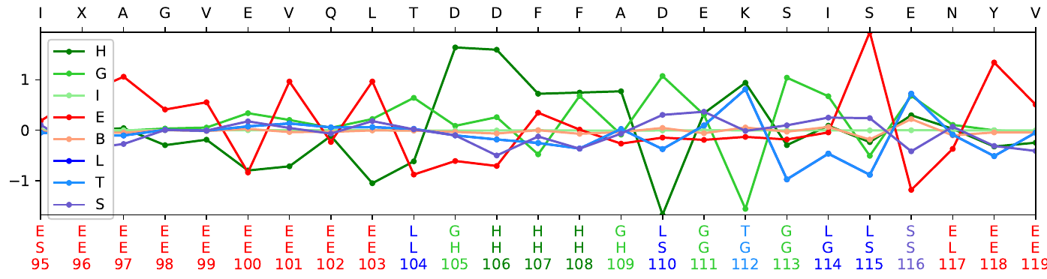
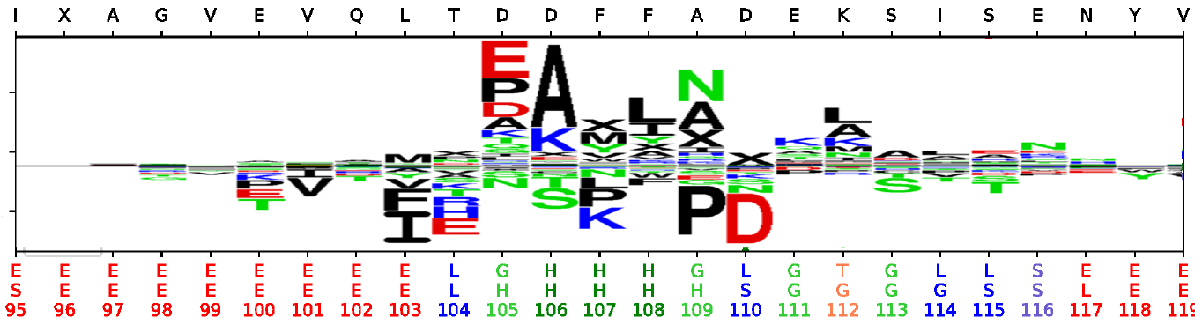
This sort of graph shows influence in the vicinity, not for the specific position
It is also important to take into account that most valuable information comes from pssm and not amino-acis

Slide 22
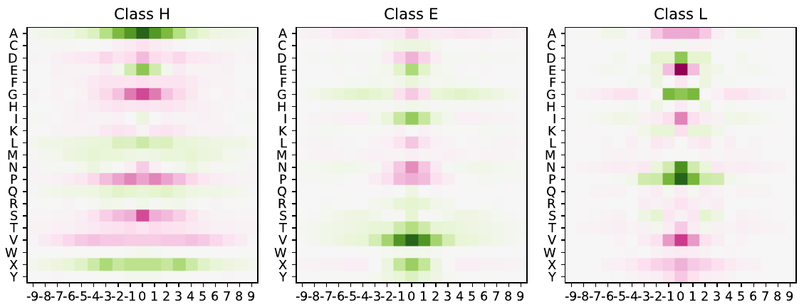
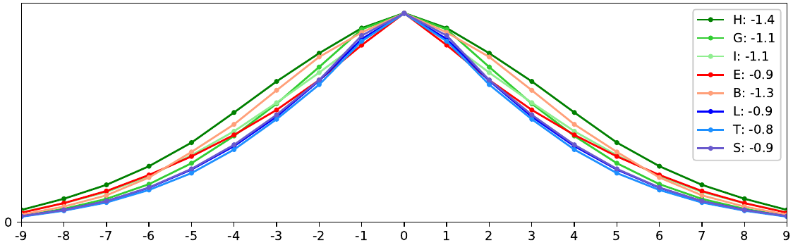
Class-specific saliecy maps
By adding up all 1.3m into a single one (only pssm)
Mirrored (right-left is irrelevant)

Slide 23
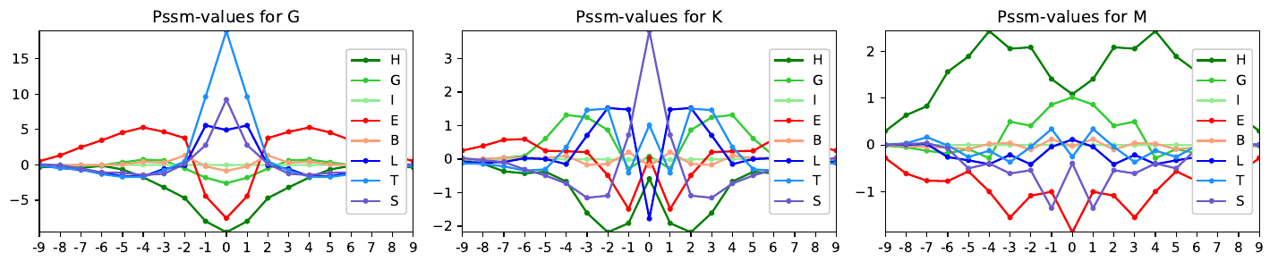
Amino-acid specific saliency maps
For understanding single pssm amino-acids, how they affect the classes depending on their position
Some pssm values are more influential than others (see scale)

Slide 24
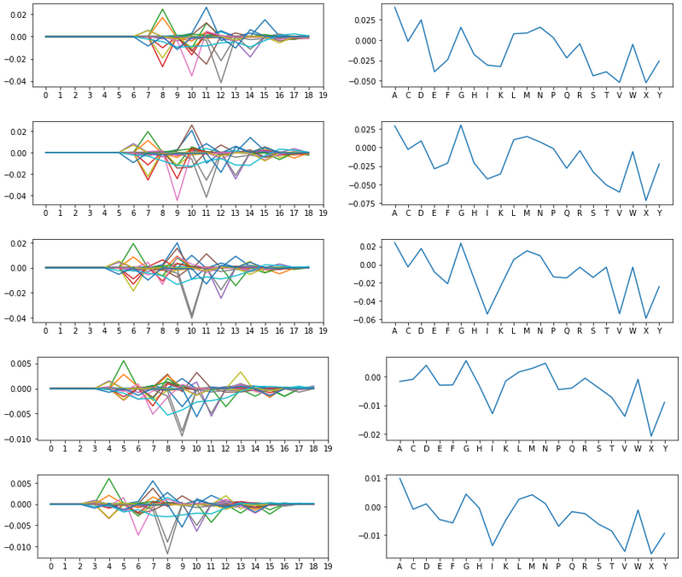
Clustering saliencies
By aggregating each saliency on its window length (right), the motifs are preserved
Clustering on the saliencies (cosine) in the positions with high prediction for one class can show different kinds of motifs that activate that class

Slide 25
What’s next? (wrapping up)
Cosine clustering does not work now due to memory problems (100 GB RAM)
Results part written, carry on with methods, theory, introduction and conclusion
Future research
Analyze worst predicted sequences by comparing their functions on SwissProt
Implement more advanced saliency map techniques
Implement class optimization

